Slide 1
Analysis of Messy Measurement Data
Spearman’s rank correlation
  rank each variable separately
  calculate correlation of the ranks

Slide 2

Large sample approximation
One-sample or paired Wilcoxon Signed Rank test
Test statistic
Two-tailed test: Rejection region |Z|>Z_{α/2}
One-tailed test: Rejection region Z>Z_{α}
(or Z<Zα )

Slide 3
Spearman Rank Correlation Example
The Spearman correlation evaluates the monotonic relationship between two continuous or ordinal variables.
In a monotonic relationship, the variables tend to change together, but not necessarily at a constant rate.
The Spearman correlation coefficient is based on the ranked values for each variable rather than the raw data.
Spearman correlation is often used to evaluate relationships involving ordinal variables.

Slide 4
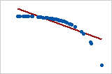
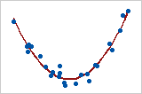
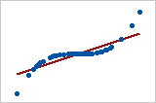
Spearman Rank Correlation Illustration
Pearson = −0.799, Spearman = −1
Coefficient of 0
This graph shows a very strong relationship. The Pearson coefficient and Spearman coefficient are both approximately 0.
Pearson = +0.851, Spearman = +1

Slide 5
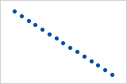
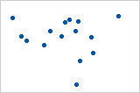
Pearson = +1, Spearman = +1
Pearson = −0.093, Spearman = −0.093

